Slide 1
NAFTA vs European Union
Student’s Name
Institutional Affiliation

Slide 2
Introduction
The European Union (EU) and the North America Free Trade Agreement (NAFTA) are the world’s two greatest economies.
A country must be competitive in the global economy with its exports. This is typical in NAFTA and the EU.
This analysis will examine the comparative economic data for these economies.

Slide 3
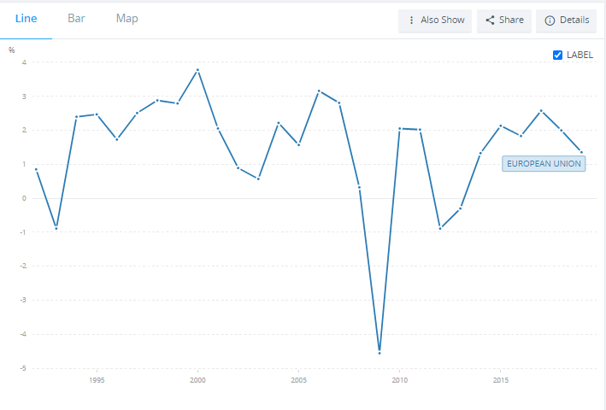
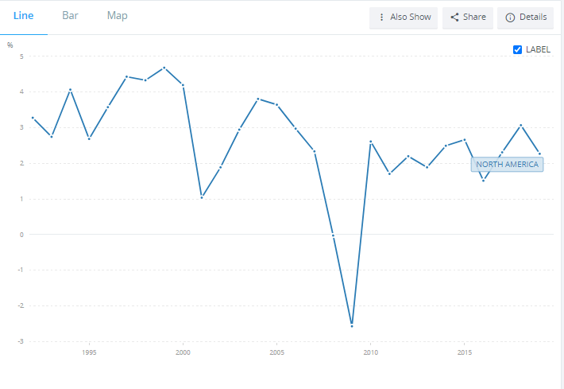
Country GDP per Capita Growth Over-Time
EU
NAFTA
(The World Bank, 2018)
Notes:
The EU has a GDP growth rate of 1.3% compared to NAFTA’s 2% in 2019. Overall, NAFTA has had a higher GDP per capita growth rate.

Slide 4
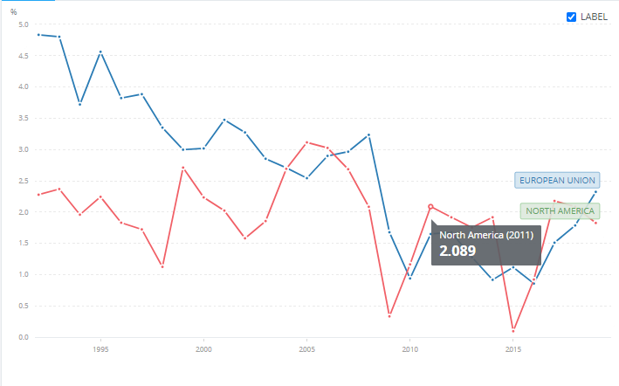
Inflation Rate over time
The World Bank, 2020)
Notes:
The European Union has had a higher inflation rate over the time under investigation compared to NAFTA. In 2019, the EU had an inflation rate of 2.324% while NAFTA recorded an inflation rate of 1.827%.

Slide 5
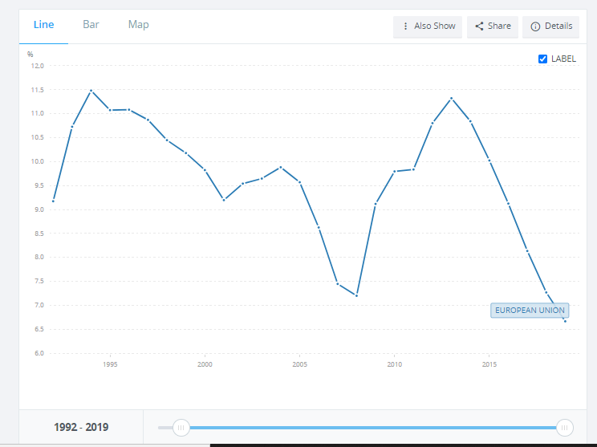
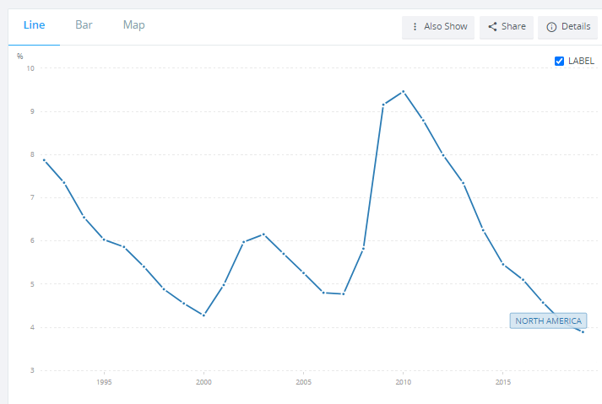
Unemployment Rate
EU
NAFTA
(The World Bank, 2018)
Notes:
In 2019 alone, this data suggests that unemployment rate in the EU has been equivalent to 6.667 while that of NAFT was 3.89. The data suggests that 2019 was the year affected most with lowest rates of unemployment affecting people within the two regions.

Slide 6
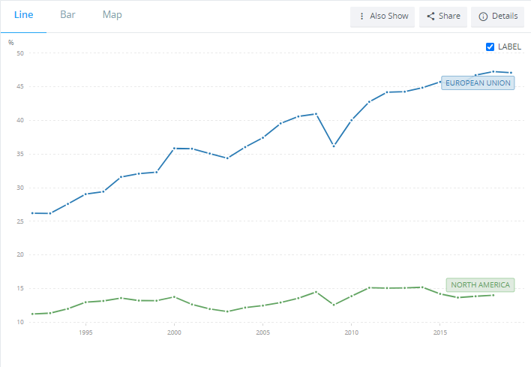
Exports as a Percentage of GDP Overtime
(The World Bank, 2018)
Notes:
The European Union has had higher percentage of exports as a percentage of GDP since 1992. In 2019 alone, it recorded a 73.779% compared to NAFTA’s 23.361% in the same year.

Slide 7
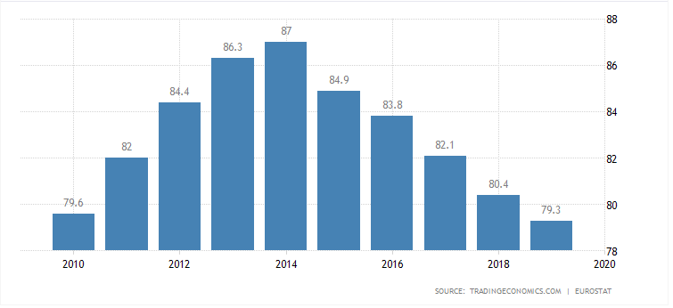
National Government Debt as Percentage of GDP
European Union
(Trading Economics, 2020)
Notes:
The European Union has had a very fluctuating government debt ratio to its GDP with the lowest coming in 2020 at 79.3. The highest was recorded in 2014 at 87.

Slide 8
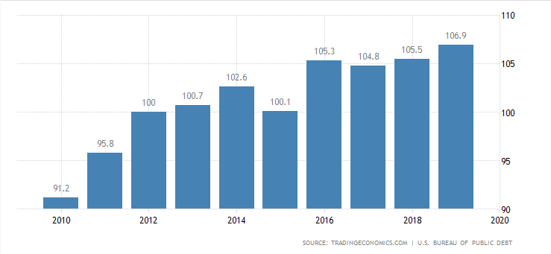
NAFTA
(Trading Economics, 2020)
Notes:
The country has been experiencing an increasing government rate compared to its GDP over time. The highest figure was recorded in 2020 as 106.9 with the lowest coming as 91.2 in 2010.

Slide 9
Reasons for Varied Economic Growth
The free movement of people within the EU has boosted economic activities as people are free to move from the EU countries and transact business activities.
There is also the use of a common currency within the EU which facilitates economic growth.
NAFTA has a restricted movement of people within the block as there are strict border policies by the member countries. This limits business activities. However, there is free movement of goods and services within member states, thus enhancing trade.

Slide 10
Analysis of trade statistic distortion
Value-added trade measures adjust flaws to bilateral trade, minimizing trade with other countries.
Failure to use such data presents practicality and data issues as it will reduce the value of goods.

Slide 11
Products with a Comparative Advantage
The manufacturing industry has clearly provided NAFTA a comparative trade advantage over the EU.
The United State’s car manufacturing industry has provided NAFTA the much needed comparative advantage as it makes the bulk of the region’s trade products competing with those produced by the EU countries (Mzumara, Chingarande & Karambakuwa, 2012).
Car parts from Canada are exported globally with only Japan exporting more than Canada giving it a comparative advantage of the EU.

Slide 12
Cont
The EU gains its comparative advantage of NAFTA in respect to its manufacturing industry, specifically aerospace. Europe is the leading manufacture of aircrafts and aerospace equipment globally (Mzumara, Chingarande & Karambakuwa, 2012).
The electronics and software industry in Europe accounts for one of the best globally. Compared to NAFTA, the industry has given it a comparative advantage.

Slide 13
Conclusion
A country’s economy majorly depends on many factors such as are trade, unemployment, GDP, Inflation, Open Trade and Politics.
The explored aspects in NAFTA vs the European Union indicates the major role played by these factors in economic growth.

Slide 14
The World Bank. (2018). Trade (% of GDP) | Data. worldbank.org. Retrieved from https://data.worldbank.org/indicator/TG.VAL.TOTL.GD.ZS?end=2018&locations=EU-XU&start=1992
The World Bank. (2018). GDP per capita growth (annual %). NAFTA. Retrieved from https://data.worldbank.org/indicator/SL.UEM.TOTL.ZS?end=2019&locations=EU&start=1992
The World Bank. (2018). GDP per capita growth (annual %). Retrieved from https://data.worldbank.org/indicator/SL.UEM.TOTL.ZS?end=2019&locations=XU&start=1992
https://data.worldbank.org/indicator/NE.EXP.GNFS.ZS?end=2019&locations=EU-XU&start=1992
The World Bank. (2018). GDP per capita growth (annual %). Retrieved from https://data.worldbank.org/indicator/NY.GDP.MKTP.CD?end=2019&locations=EU&start=1992
Mzumara, M., Chingarande, A., & Karambakuwa, R. (2012). An Analysis of Comparative Advantage and Intra-North American Free Trade Agreement (NAFTA) Trade Performance. Journal of sustainable development, 5(11), 103.
The World Bank. (2020). Inflation, GDP deflator (annual %) - European Union, North America. Retrieved from https://data.worldbank.org/indicator/NY.GDP.DEFL.KD.ZG?end=2019&locations=EU-XU&start=1992&view=chart
Trading Economics. (2020). NAFTA Federal debts to GDP. Retrieved from: https://tradingeconomics.com/united-states/government-debt-to-gdp
Trading Economics. (2020). European Union Debt to GDP. Retrieved from https://tradingeconomics.com/european-union/government-debt-to-gdp

